Slide 1

Fake News Detection Project
Khushboo Khatri

Slide 2
Introduction
About Project | DATASET | Visualization | Data Cleaning
this include the introduction phase of project | This tells us about the dataset | This include visualization and EDA | This include pre processing of data
DATA SPLITTING | VECTORIZATION/ENCODING | MODEL BUILDING | SUMMARIZATION/ CONCLUSION
This include splitting data into train cv and test. | Converting text data into vector form | Building the model | Summarizing and concluding the project.

Slide 3
About Project
Fake news has become one of the biggest problems of our age. It has serious impact on our online as well as offline discourse. One can even go as far as saying that, to date, fake news poses a clear and present danger to western democracy and stability of the society.
What is a Fake News?
Fake news's simple meaning is to incorporate information that leads people to the wrong path. Nowadays fake news spreading like water and people share this information without verifying it. This is often done to further or impose certain ideas and is often achieved with political agendas.
For media outlets, the ability to attract viewers to their websites is necessary to generate online advertising revenue. So it is necessary to detect fake news.

Slide 4
DataSet
We got our dataset from our internship organization, and it has been told that it is downloaded from Kaggle. There are two datasets one for fake news and one for true news. In true news, there is 21417 news, and in fake news, there is 23481 news. You have to insert one label column one for fake news and zero for true news. We are combined both datasets using pandas built-in function.

Slide 5
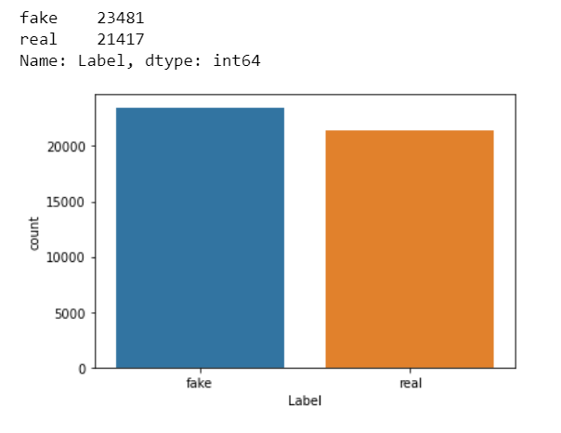
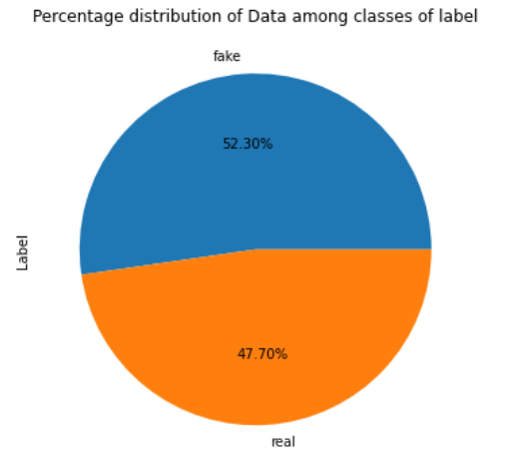
Visualization /EDA
Above plots shows the distribution of fake and real news in our final dataset, first plot shows the numerical representation while the second plot shows the %age distribution.

Slide 6
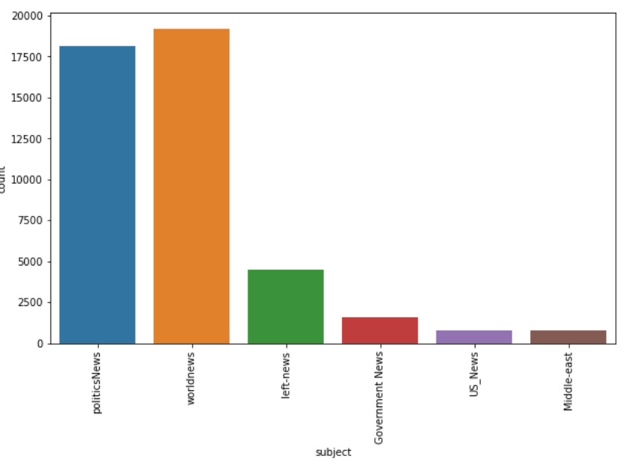
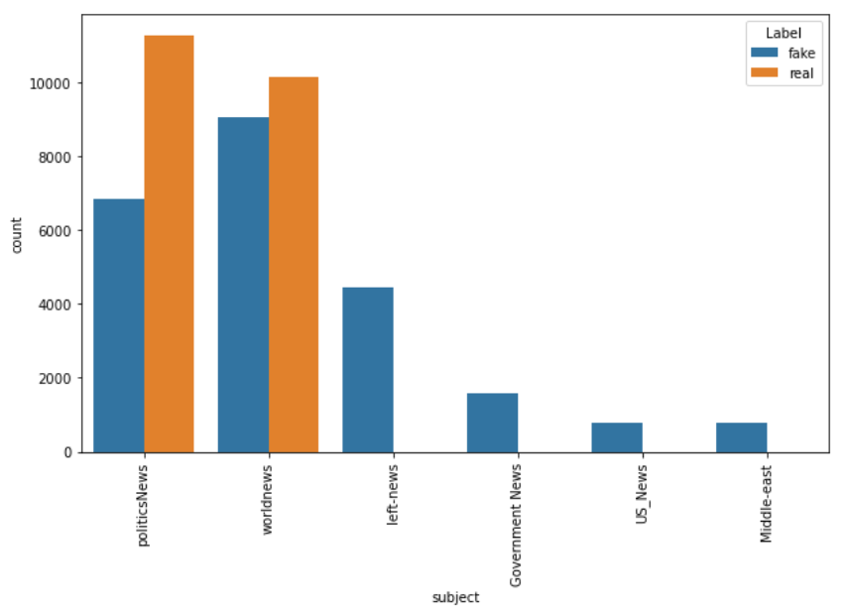
These two plots are of subject column, first plot defines the distribution of news data among various subjects. While the second plot shows the distribution of real and fake news among those subjects.
We observe that most of the real news is from politics and worldnews while all other columns are fake news along with these two.

Slide 7
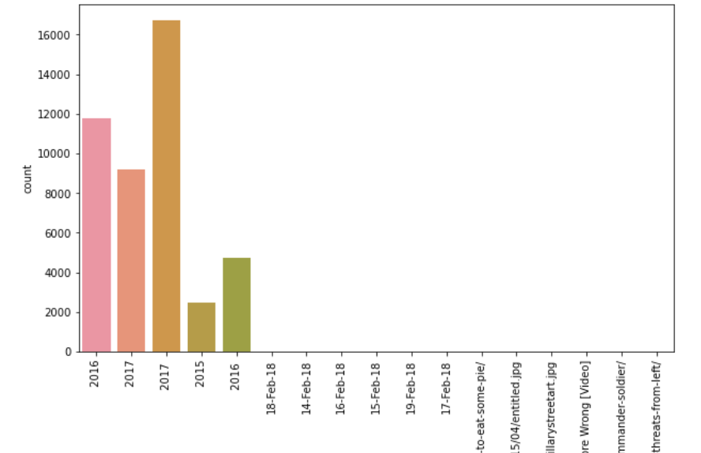
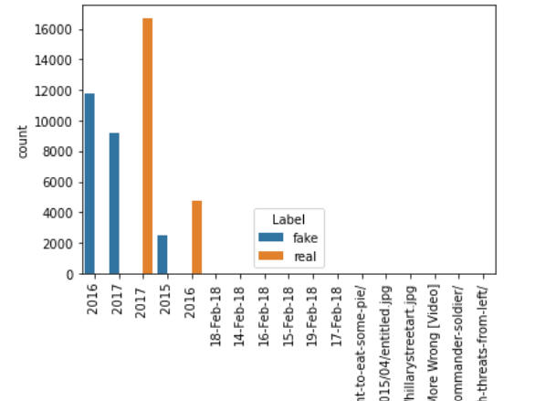
From these plot it is clear that the distribution of year among the dataset is not proper, first plot shows data distribution among the year 2015, 2016, 2017, we got two 2016 and 2017 looks like the year distribution for fake and real news is not tallied properly in feature extraction.
The second plot shows fake and real news over the years, we observe that we got real news for year 2016 and 2017. while we got fake news for year 2015, 2016, 2017.

Slide 8
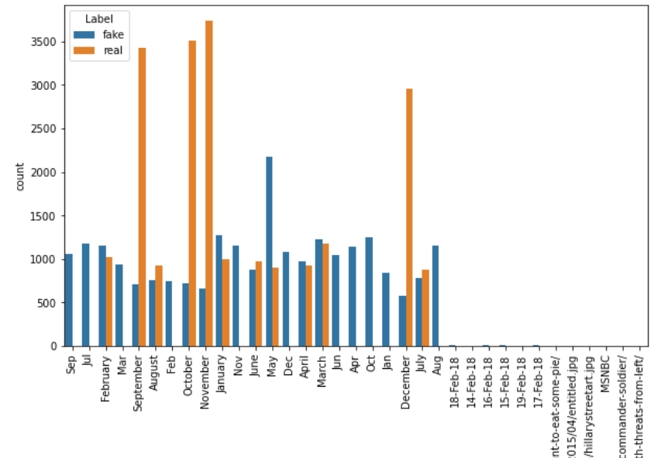
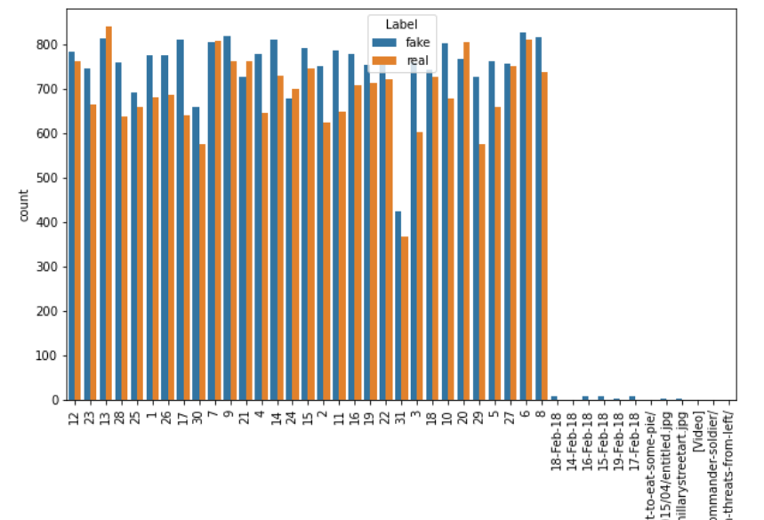
From above two plots, the left plot indicate the news distributions over the months, again here also we see that we got abbreviation along side of full form of month. The data distribution is completely random, which makes me realise that may be date columns are not that correlated with our target column we can drop it as it is.
Similar fashion can also observe in the right side plot which shows the distribution of news on various dates.
We will drop year month and date column which is the outcome of feature extraction of date column. As it is an NLP problem which deals with only text also we don’t find any direct connect between date feature and Label.

Slide 9
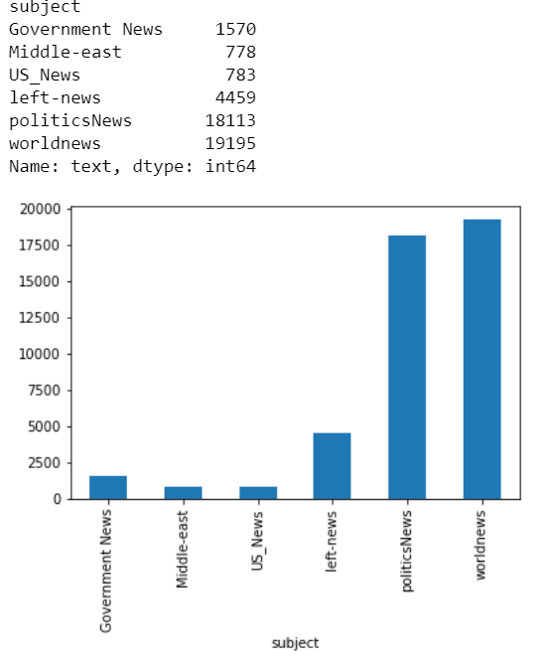
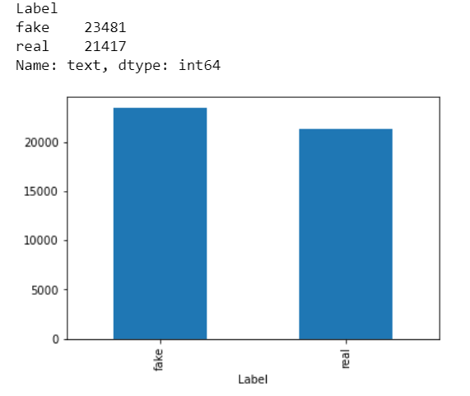
From above, the left plot indicates the number of articles per subject , while the plot on right indicates the number of fake and real articles.

Slide 10
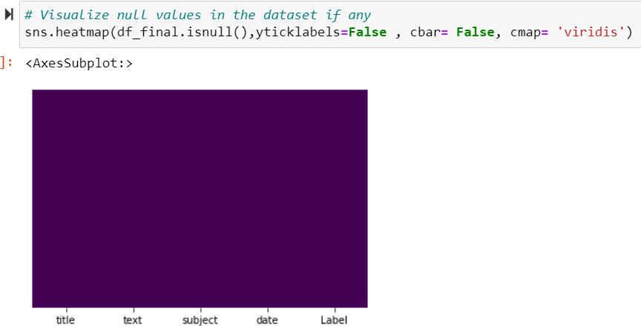
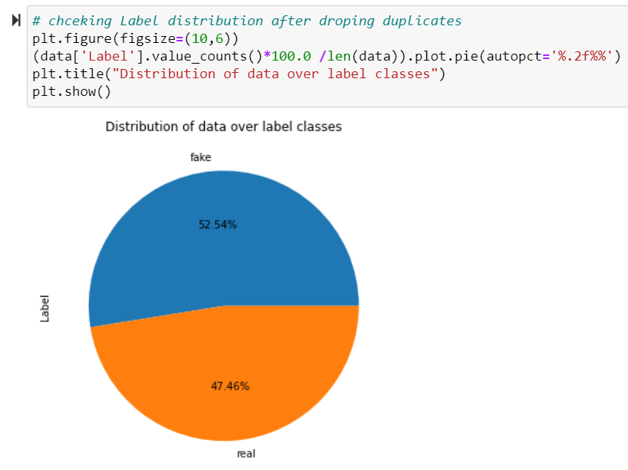
The left plot indicates that there is no null value present in our dataset, we are safe to processed with this dataset. The plot on the right indicates the %age distribution of data over fake and real news after we drop the duplicates from the dataset.

Slide 11
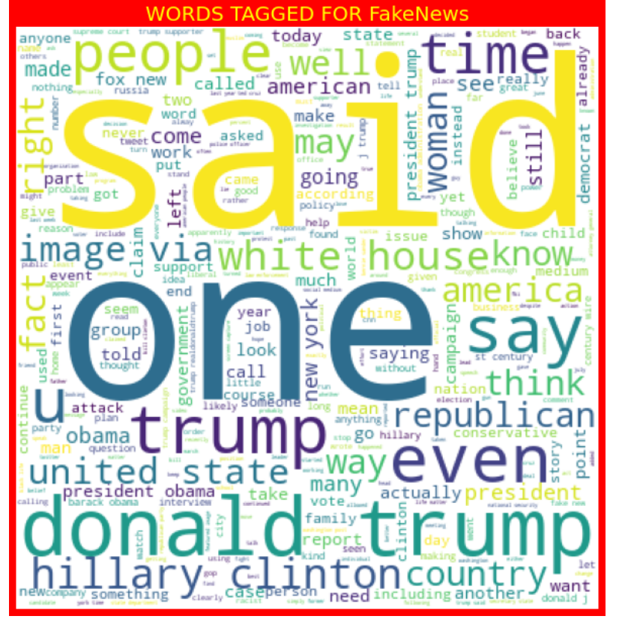
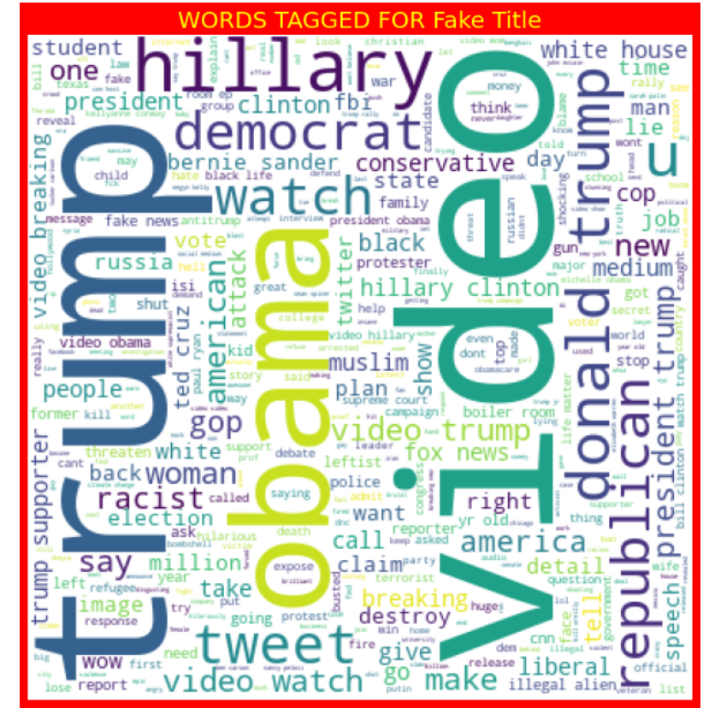
The plot in the left indicates the word cloud for text of the fake news, while the plot on the right indicates the word cloud of the title of fake news.
Both of the wordcloud contain maximum of 400 words which appears more frequently in the text and title of fake news. The large font words are the most recurring words in the text and title of the Fake news.

Slide 12
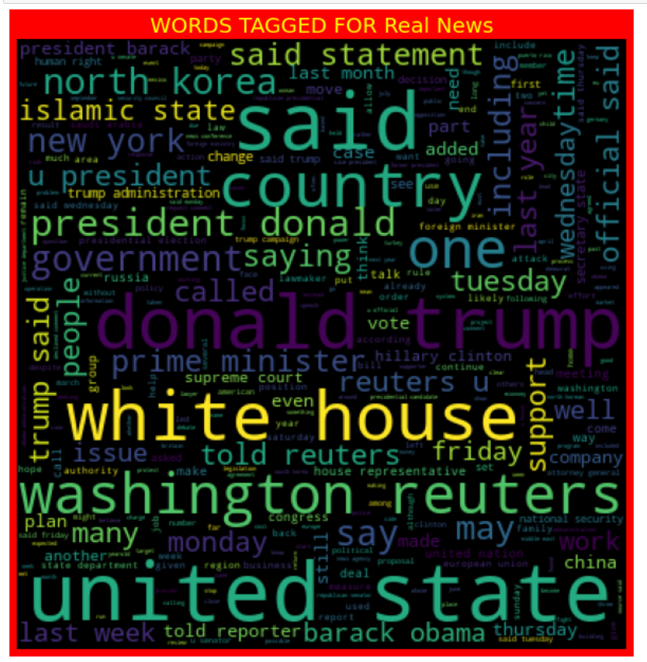
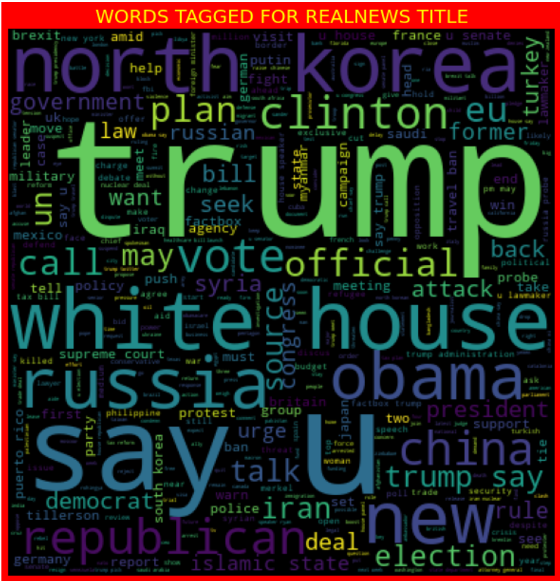
From above two plots, the left plot indicates the wordcloud for real news text, while the right plot indicates the real news title.
This also consist of maximum 400 words which mostly appears in the real news text and title on the basis of which out model detect whether it is a real news of fake news.

Slide 13
Data Pre-Processing
We define a function for cleaning the data both text and title columns of the dataset. Which follows following steps:
1. converting data to lower case
2. removing stop words
3. removing punctuations
4. expansion of English language, removing hyperlinks, emails, special character, numbers etc.
5. lemmatize the data
6. we follow same steps for text and title column.
This is basically data cleaning part, from here we got pre processed clean data, which we are going to use further in the project.

Slide 14
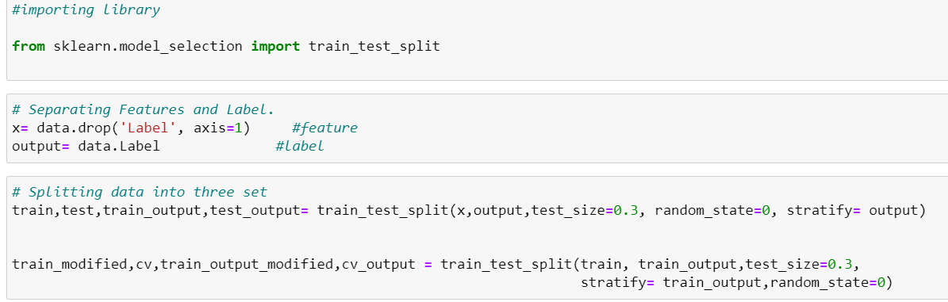
Splitting data
We split our pre processed data into first feature and label(output) category then further split them into train , cv, test dataset using train_test_split().
Here we train the data using train dataset , cv dataset is used for cross validation purpose and test dataset for test purpose in the model building.
By dividing data into three set helps in improving the efficiency of the model and also prevents data leakage.

Slide 15
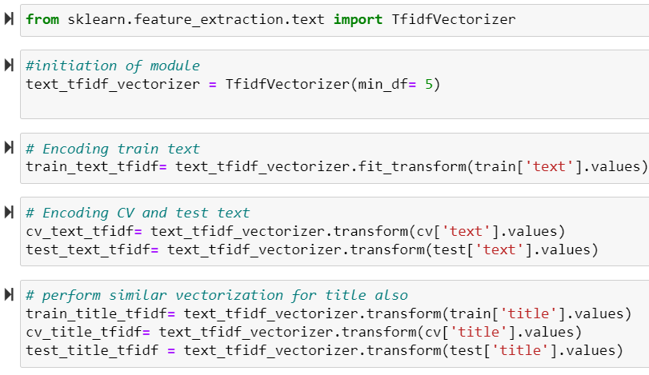
Vectorization/ Encoding
For our text and title pre processed column we need to change them into vectors which are machine understandable, which then will be used in the model building purpose. And for our label data, we use map () we map fake as 1 and real as 0.We also perform label ender in subject column.
For vectorization of text data we use TFIDF Vectorizer in order to change text to vectors. One thing to note here is that we perform similar operations on both the text and title column.

Slide 16
Model Building
In order to build a model, we first need to merge all the pre processed vectorized feature column, to form one dataframe. For that purpose we will use hstack.
Following are the classification approach we carried in our project:
1. MultinomialNB
2. Logistic regression
3. RandomForest Classifier
4. Decision tree Classifier
5. SVC
6. XGBOOST Classifier

Slide 17
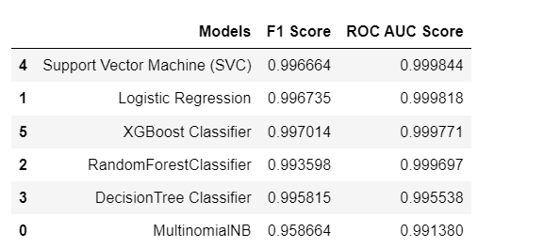
Summarizing Each Algorithm
From above we can observe that top three models are having scores almost in the same line. SVC has f1 score which is minor less than that of Logistic Regression. However the ROC AUC score of both the algorithms are almost same. In this way Logistic Regression works better than that of SVC.
By looking at the entire picture and also considering classification report and confusion matrix I think Logistic regression is better model then other two.
So we will save Logistic regression as our final model.

Slide 18
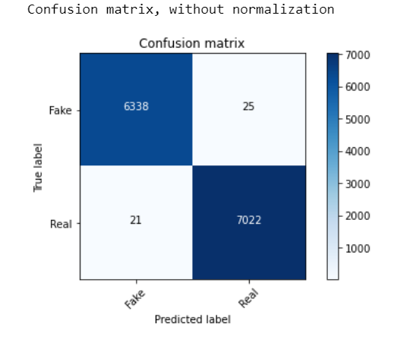
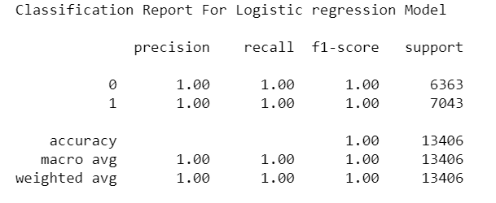
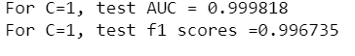
Scores for final model(Logistic Regression)
From here we can clearly see that the classification report is perfect, the roc auc score is .9998 and f1 score is also good, .9967
We also get decent score in confusion matrix.

Slide 19
Conclusion
What's inside is more than just rows and columns. Make it easy for others to get started by describing how you acquired the data and what time period it represents, too.
In our project we build a NLP model to detect fake news, here we took a fake and true dataset, the implemented some data cleaning function, then vectorized it using TFIDF vectorizer and finally build a Logistic Regression model with .99 of f1 score and .99 of roc auc score.
The confusion matrix also show high classification of accuracy, overall the model is good fit.

Slide 20
Thank You

